Slide 1
Eye SNR Calculator
Yongsheng.guo@ansys.com
2023-07-25

Slide 2
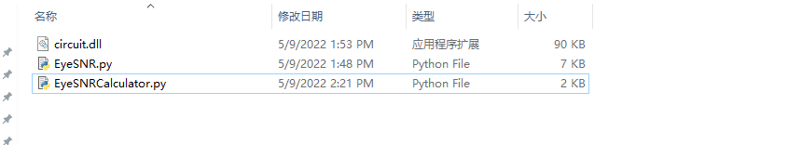
EyeSNRCalculator
The Eye SNR Calculator script is used to calculate SNR of quick eye/AMI eye in AEDT circuit, NRZ, PAM4 eye have been tested, PAM8 should support also.
SNR output in dB format.
Release on: https://github.com/YongshengGuo/EyeSNRCalculator/releases/latest
Note: For IBIS-AMI simulation The toolkit only work after 2022R2 AEDT version.

Slide 3
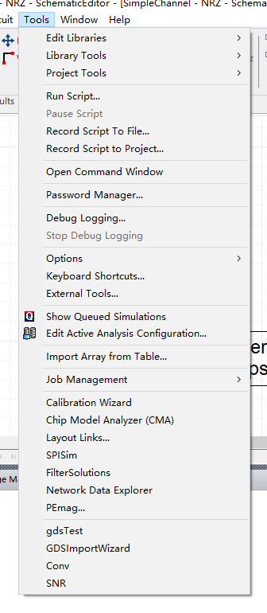
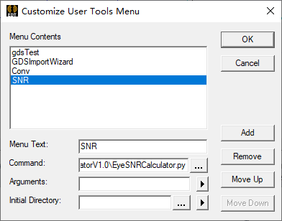
Add EyeSNRCalculator as External tools

Slide 4
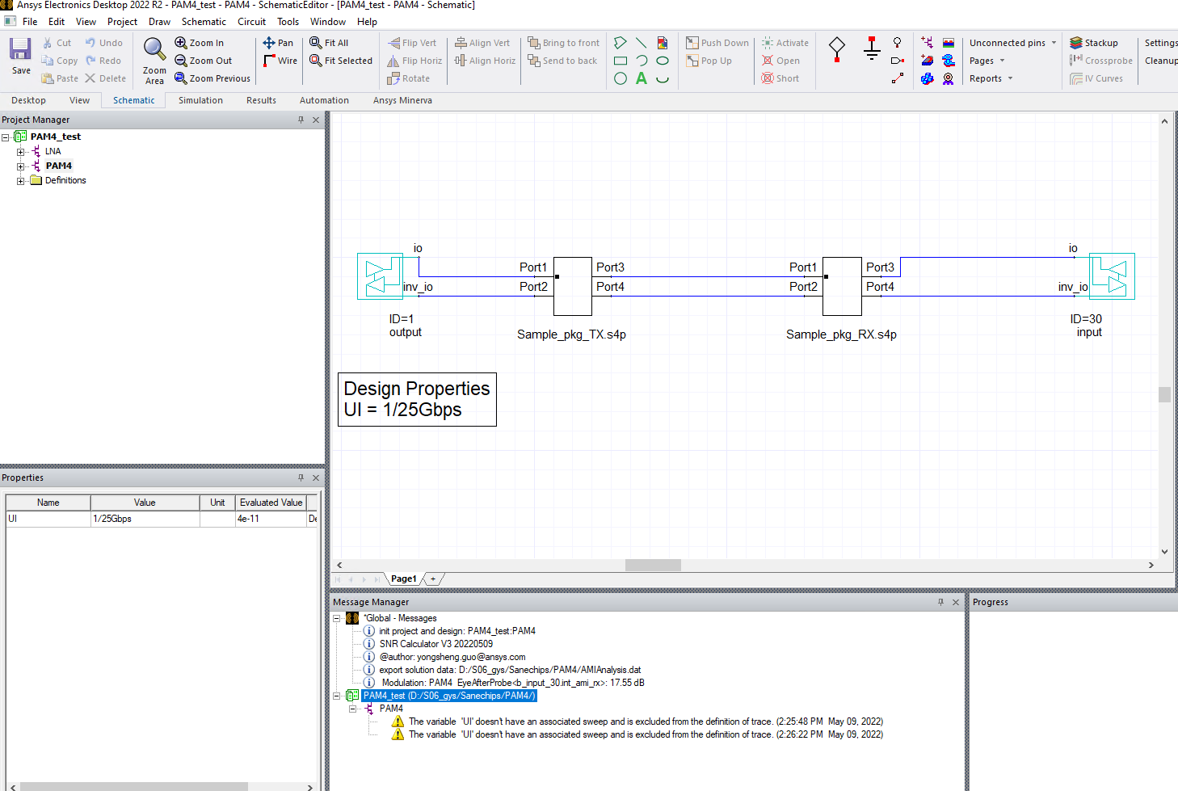
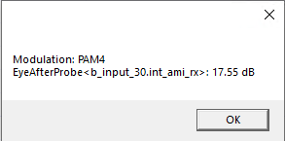
Run SNR Calculator
Run the QuickEye or IBIS-AMI bit-by-bit Eye first, then run the toolkit.
SNR(dB) Result.

Slide 5
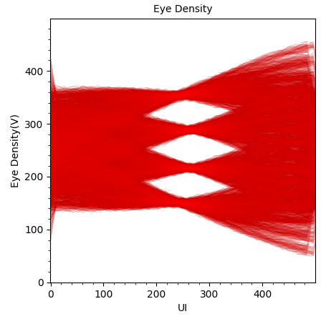
How SNR Calculator worked
40%-60% 3σ eye width
Level3
Level2
Level1
Level0
Tmid
Sample on 40%-60% of 3σ eye width
3σ eye width

